Slide 1
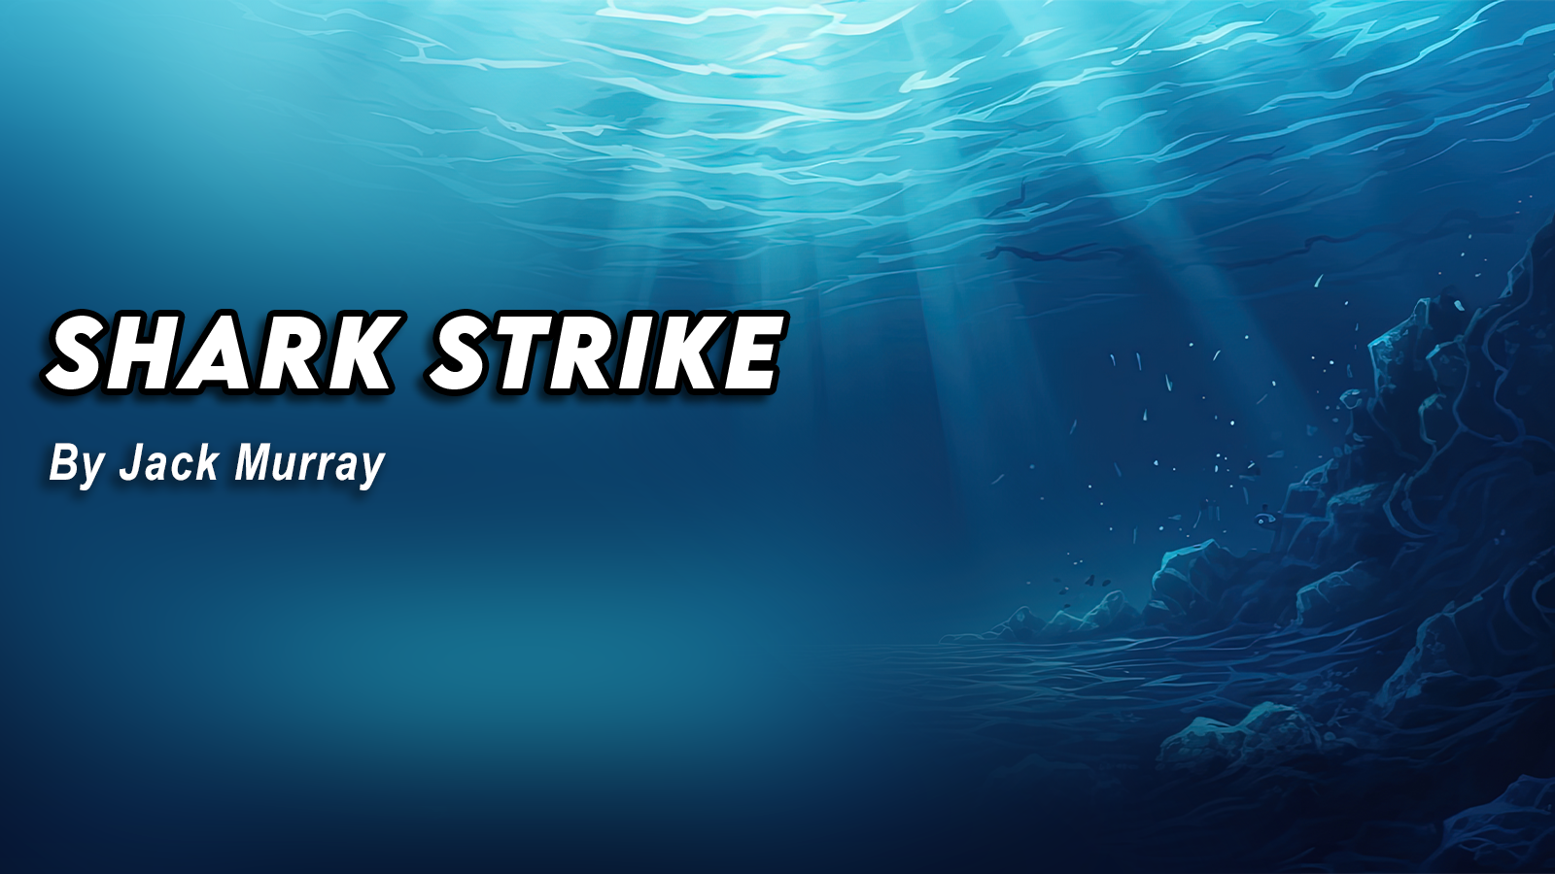

Slide 2
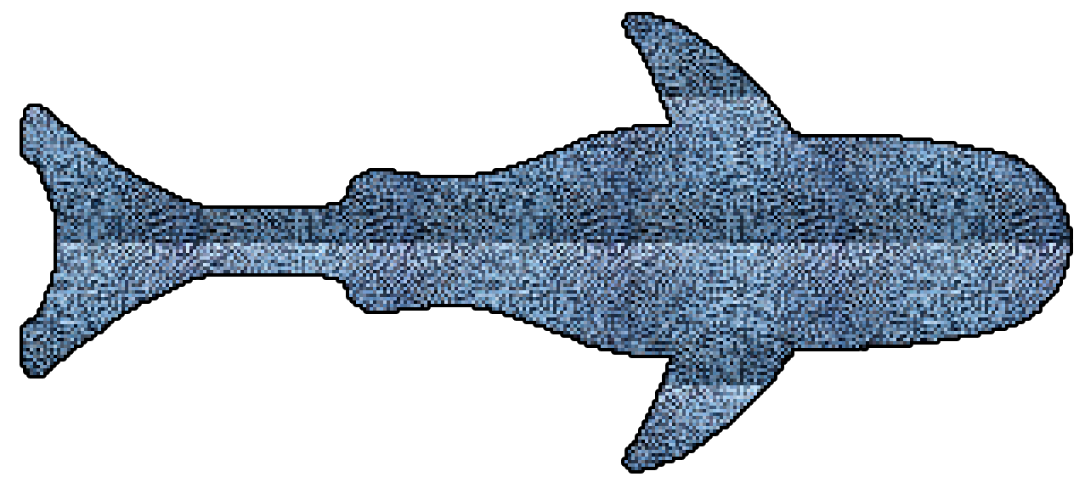
Introduction
Shark Strike is a shark-themed casual top-down shooter
Goal: last as long as you can while defending yourself from bigger sharks (enemies)
Infinitely progressing, difficulty increase with time
hyper casual gaming
Developed for Android due to userbase
Figure 1: Pixel art shark asset

Slide 3
Demographic
The demographic for my game is anyone above the age of 3 (3+)
This is due to the infinitely progressing difficulty.
May end up being too difficult for younger users.

Slide 4
Market Research
Overall market research- Hyper-Casual gaming:
In 2022, 17.4 BILLION android users downloaded and played games tagged ‘hyper casual’
Top-down shooters are a growing market area currently, with many being released every year.
Most of these games are military style, or graphic, and feature maximalist art-styles.
This concept is unique in terms of style and minimalism.

Slide 5
Mechanics and Features
Controls:
Touch and Hold to move AND SHOOT (shark will move in direction of touch while held)
Tap to shoot bubbles (will have a 0.3sec delay)
Difficulty progressing with time, increasing spawn rate and spawn amount of enemies coming in from all sides.
CandyCoded Haptics framework (for vibrations on SHOOT and menu buttons)

Slide 6
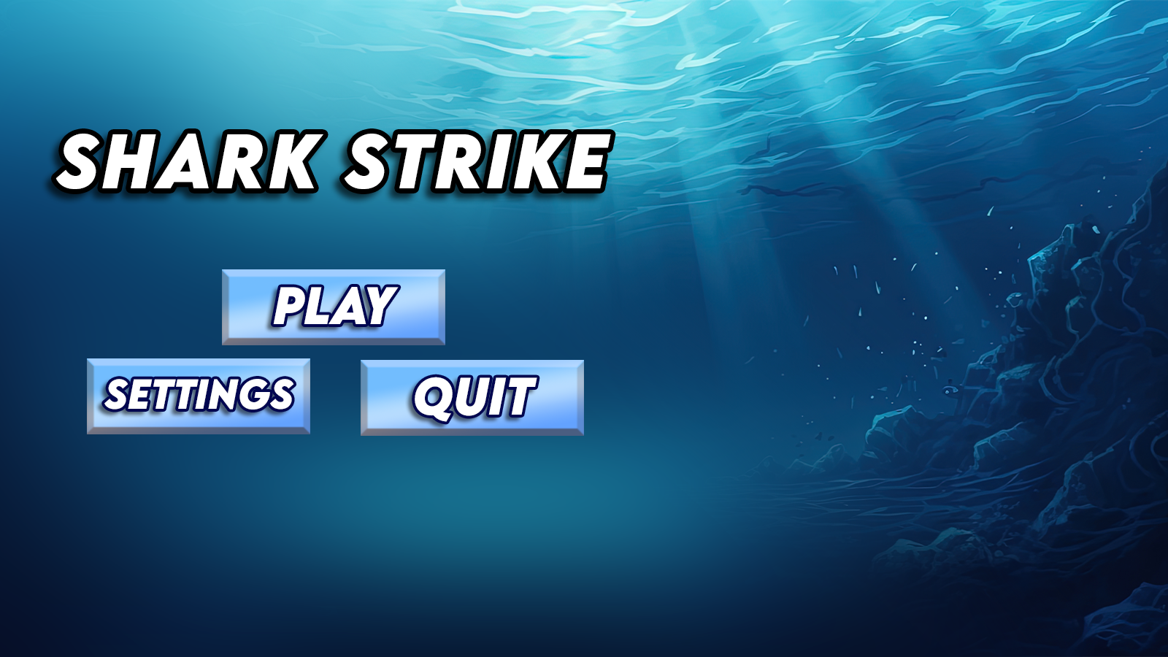
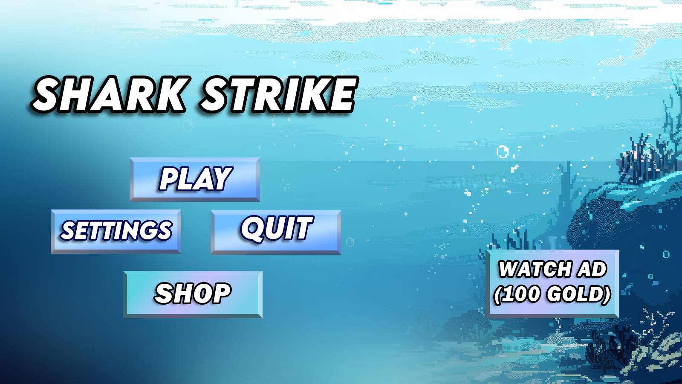
UI and level design
The UI theme for this game is very minimalistic
Easy to understand for all ages
Clean, visually appealing, easy on the eyes.
Figures 2 + 3 : Prototype Title Screen Design, Final title screen design

Slide 7
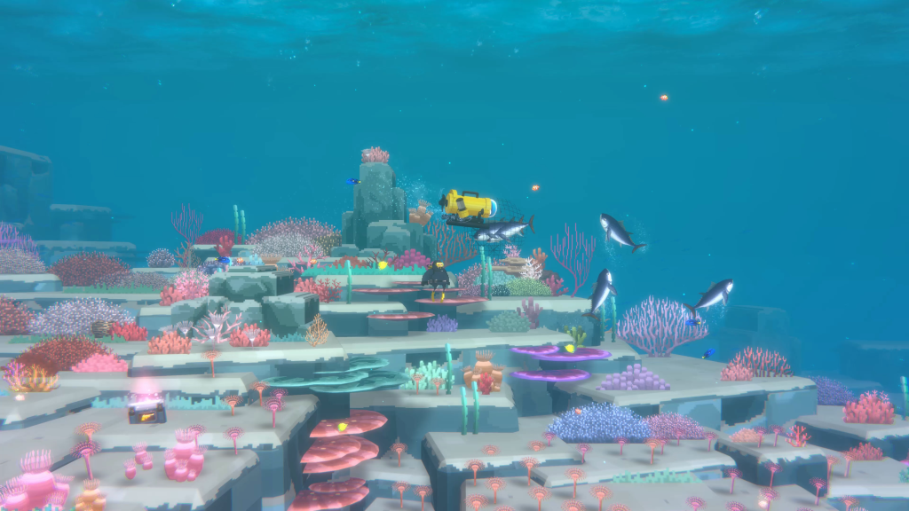
Concept art and planning
Art style - pixel art sprites, assets and backdrop
Get background art from Adobe Stock (licensed)
Take inspiration from other pixel-art such as Dave the Diver and Radiant
Figure 4: pixel art-inspiration- Dave the Diver

Slide 8
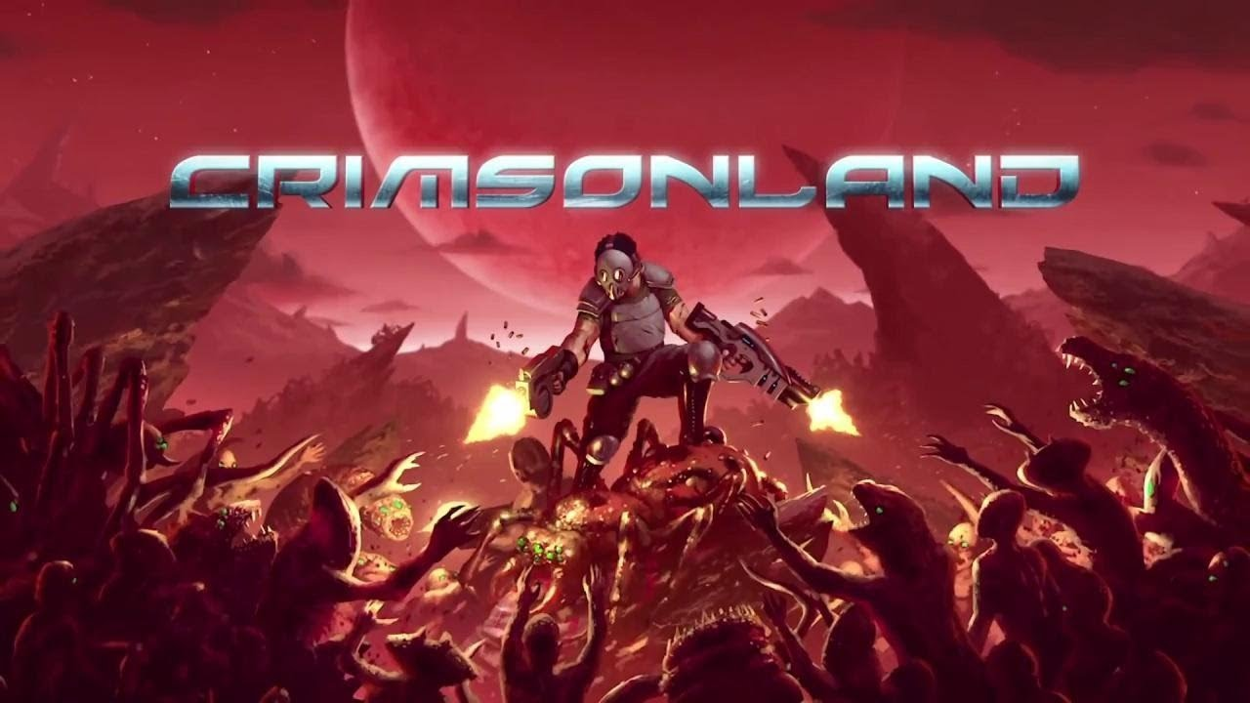
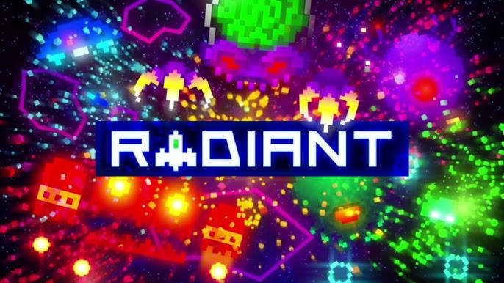
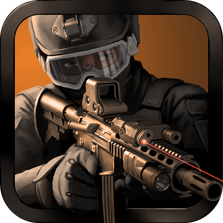
Inspiration
Figures 4, 5, 6: ‘Radiant’, ‘Crimsonland’ & ‘Warforce’

Slide 9
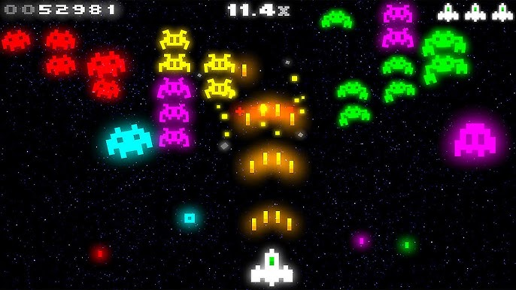
Study: Radiant
Radiant is a modernised top-down space-invaders style shooter featuring:
Unique neon pixel art style
Continuous story dialogue
An original soundtrack
This game costs £2.99
Released in 2009.
Close to 70K downloads, rated for all ages
Gross Revenue = $142,443.00
Net Revenue = $86,890.23
Figure 7: ‘Radiant’ Gameplay

Slide 10
Marketing and Monetization
Shark Strike will be marketed using social media, namely Instagram stories/reels and YouTube shorts, due to their active user-bases.
- Advertisements framework is implemented to help monetize the game by using banner and interstitial advertisements.
- In-App-Purchases framework is implemented to allow for profit when players decide to purchase coins (for ingame items such as speed booster)

Slide 11
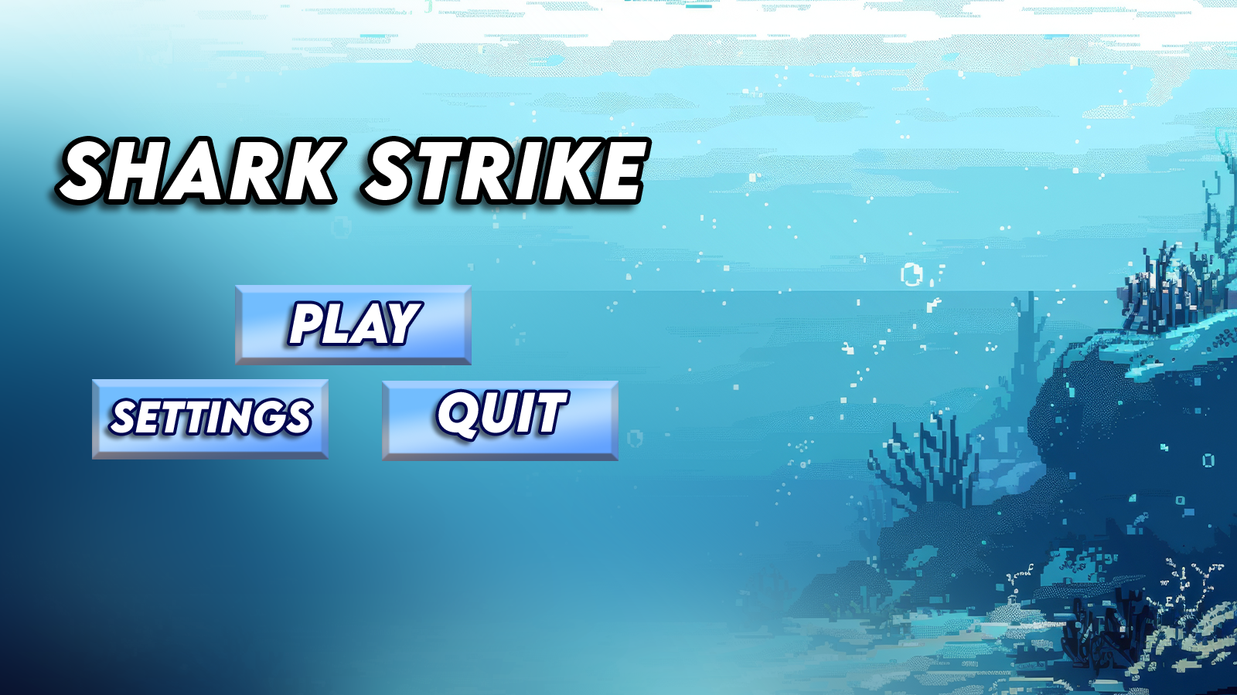
Main Menu
Here is the main menu screen
custom graphics
UI buttons
Bright and appealing
Figure 8: Finished Main Menu

Slide 12
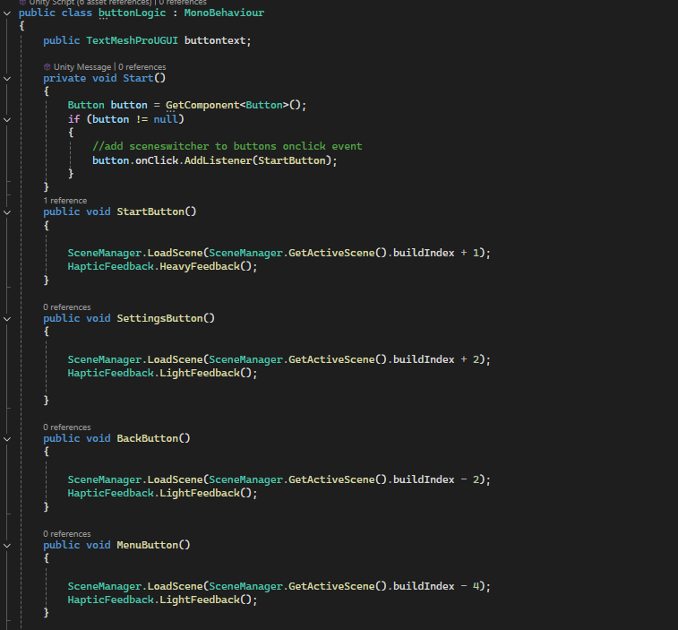
Main Menu – UI Buttons
Figure 9: Code screenshots

Slide 13
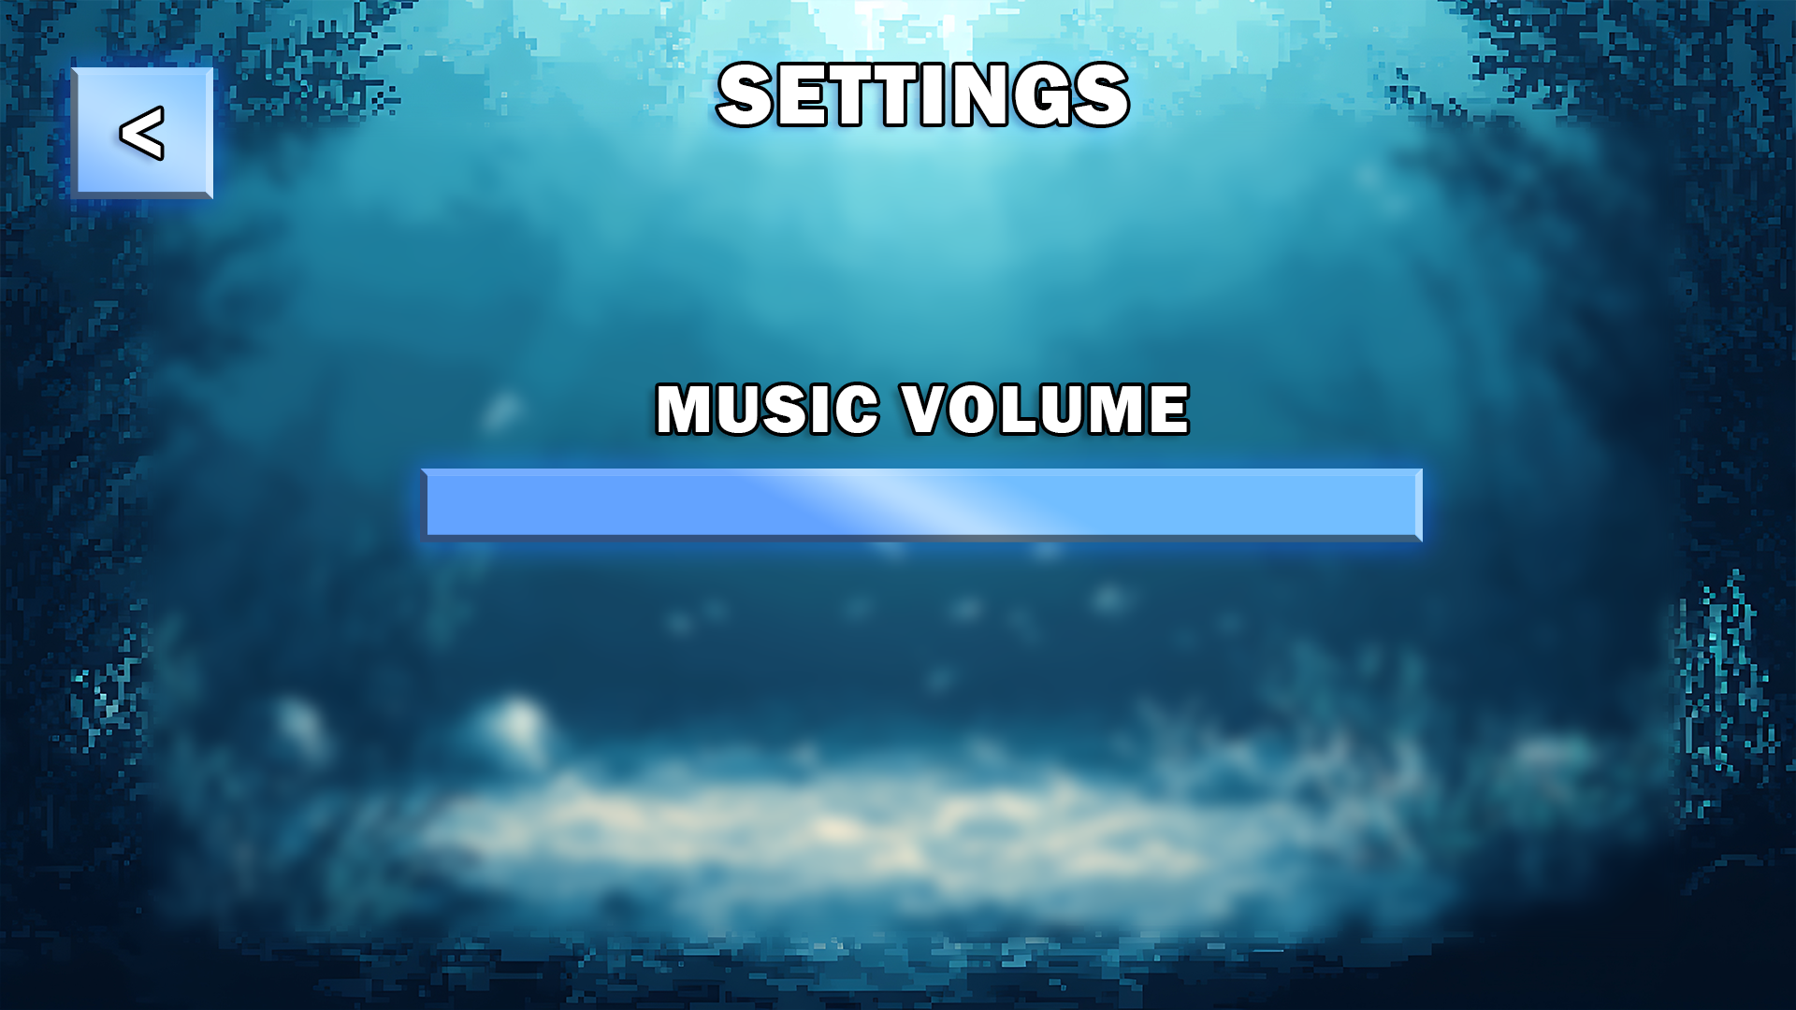
Settings Menu
Here is the settings menu screen
custom graphics
Working volume slider
In-keeping with the
ocean pixel art theme
Figure 11: Settings Menu art

Slide 14
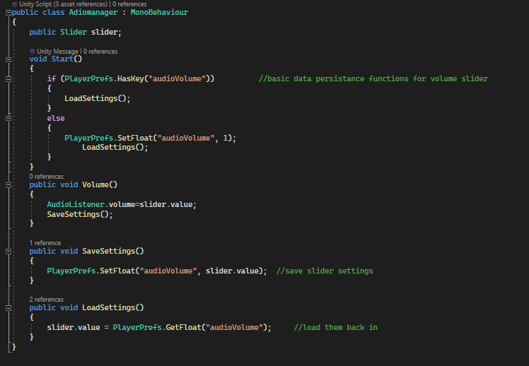
Settings Menu – Audio Slider
Data Persistence using
‘PlayerPrefs’ functionality
Figure 11: AudioManager.cs

Slide 15
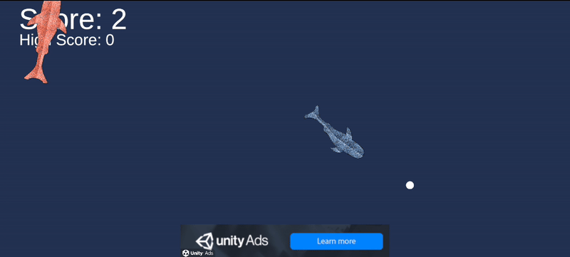
Game Scene
Here is the main game screen
Enemy AI (fully styled)
Shoot mechanics
Smoothed controls
Figure 12: Testing game scene

Slide 16
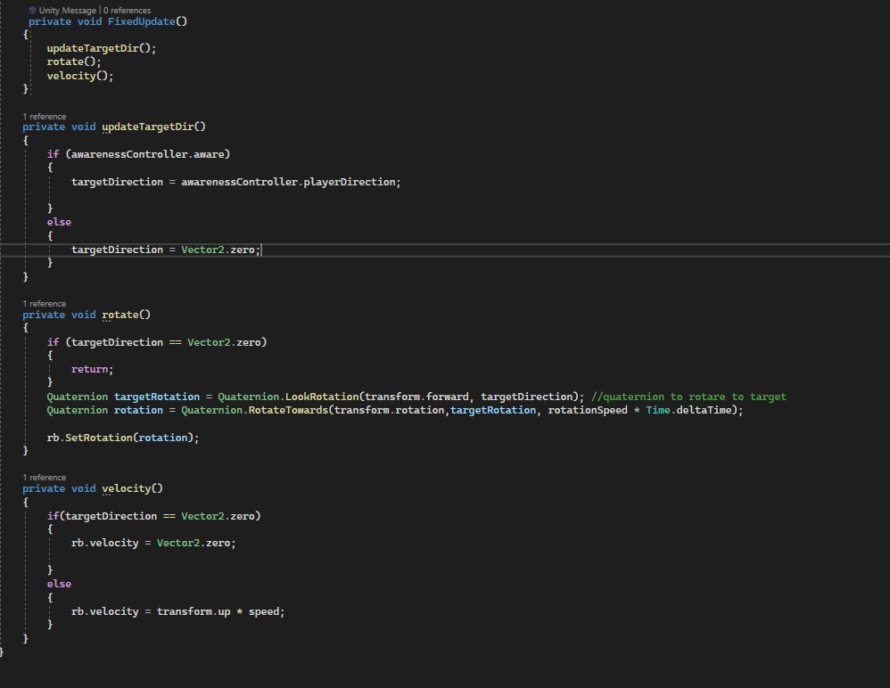
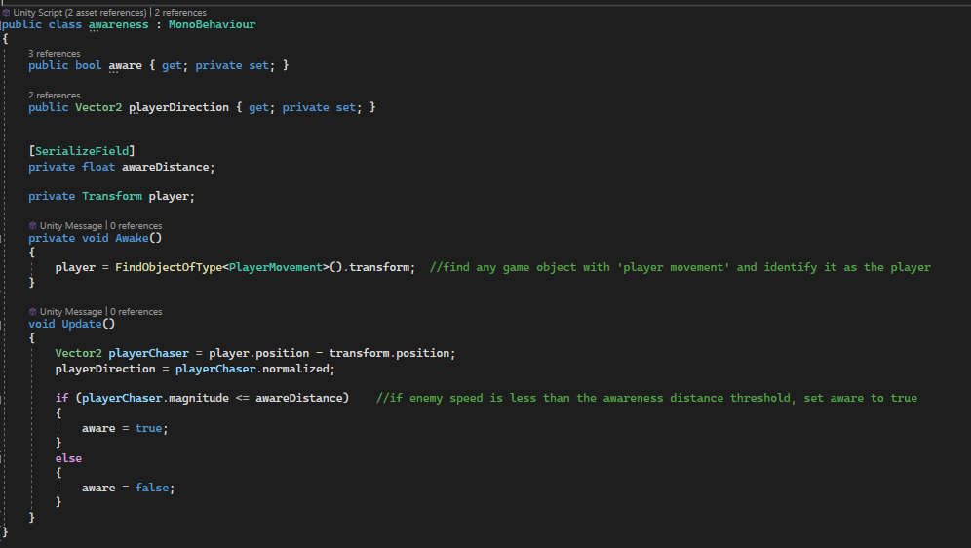
Game Scene – Enemy Scripting
Enemy Ai will rotate and follow the player when in range
Figure 13 + 14: Enemy Movement.cs, Awareness.cs

Slide 17
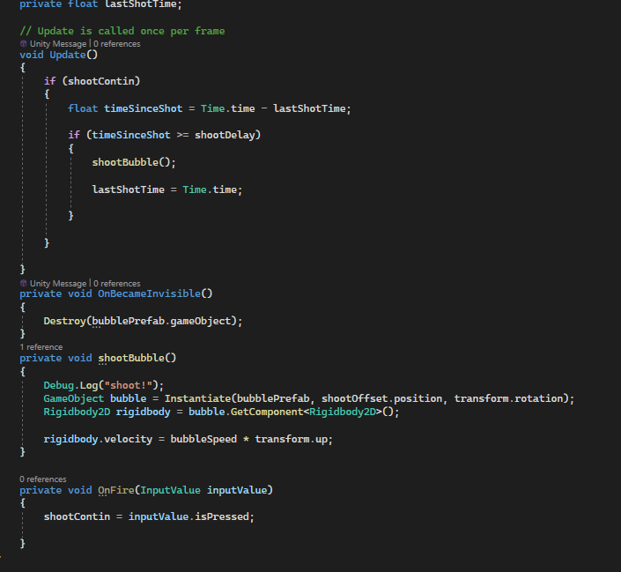
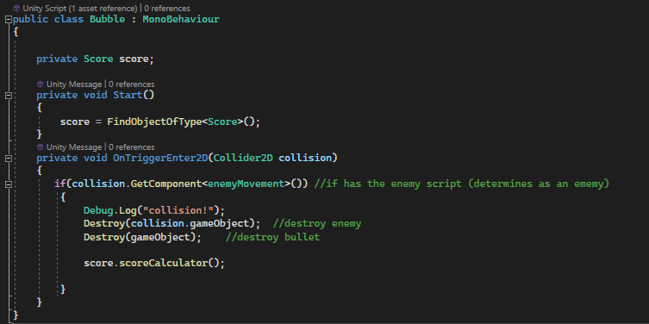
Game Scene – Shoot Mechanics
Player can shoot bullets and ‘kill’ enemy AI by tapping the screen
Figure 15 + 16: Shoot.cs, Bubble.cs

Slide 18
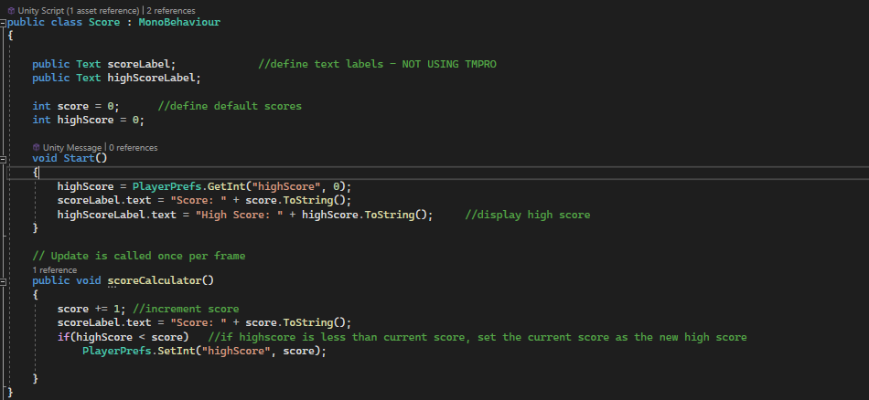
Game Scene – UI mechanics
In-game UI features a score and high score keeping mechanic (playerprefs)
Figure 17: score.cs

Slide 19
Version Control:
This project is version controlled using GitHub, the repo is linked below:
https://github.com/UkiyoJack/MobileGameDev-JackMurray/

Slide 20
References:
Background (Menu and Settings menu) from adobe stock (licensed):
https://stock.adobe.com/uk/search?k=pixel+underwater&search_type=usertyped&asset_id=811246306 Menu Music by StreamBeats (royalty free):
https://www.youtube.com/watch?v=vT7QvOK1So0&list=PL7MuRcFvY1Qc243qxB7yYlvcDBE5c-GBL&index=4&ab_channel=HarrisHeller-Topic
Shark character and all other graphics made by me
Logic help with enemy awareness – Ketra Games (YouTube)

